Slide 1


DEVELOPING MULTI-TENANT APPLICATIONS WITH .NET & ABP FRAMEWORK
Halil İbrahim Kalkan
Co-founder & Lead Architect at Volosoft
hibrahimkalkan
hikalkan

Slide 2

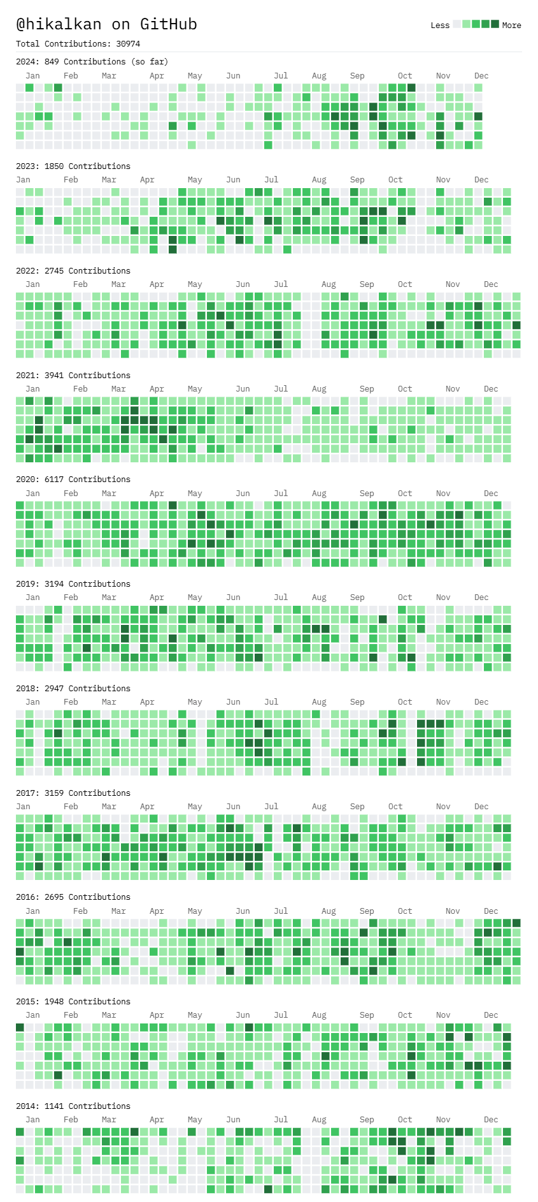







ABOUT ME: HALİL İBRAHİM KALKAN
1997, Started programming (at 14 years old, with Turbo Pascal)
2003-2007, Computer Engineering
2007 - 2015: Software developer, software architect, team leader
2013 - ∞: Lead developer of the open source ABP Framework
2016 - ∞: Co-founder, software architect
Multi-threading, distributed/microservice systems, OOP, DDD, software architectures.. etc.
Still active coder, open-source contributor
30,000+ total contributions on GitHub

Slide 3
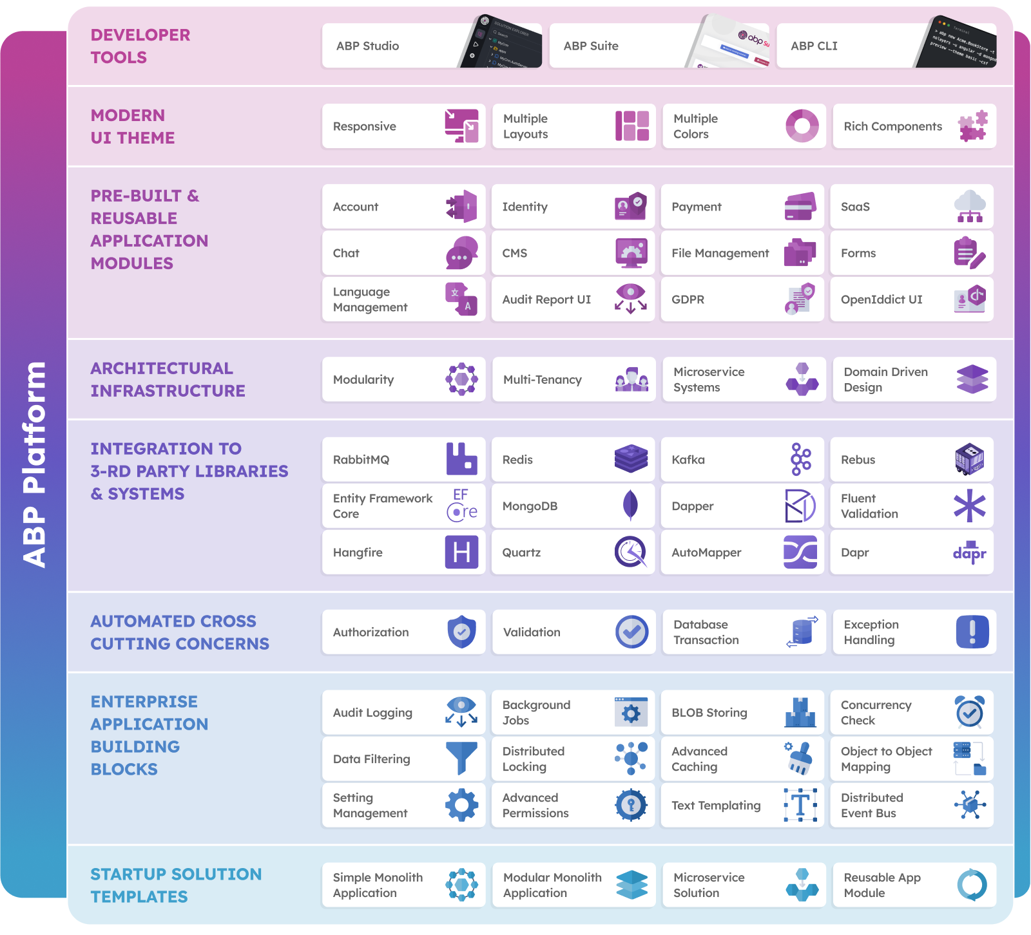
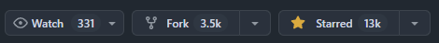

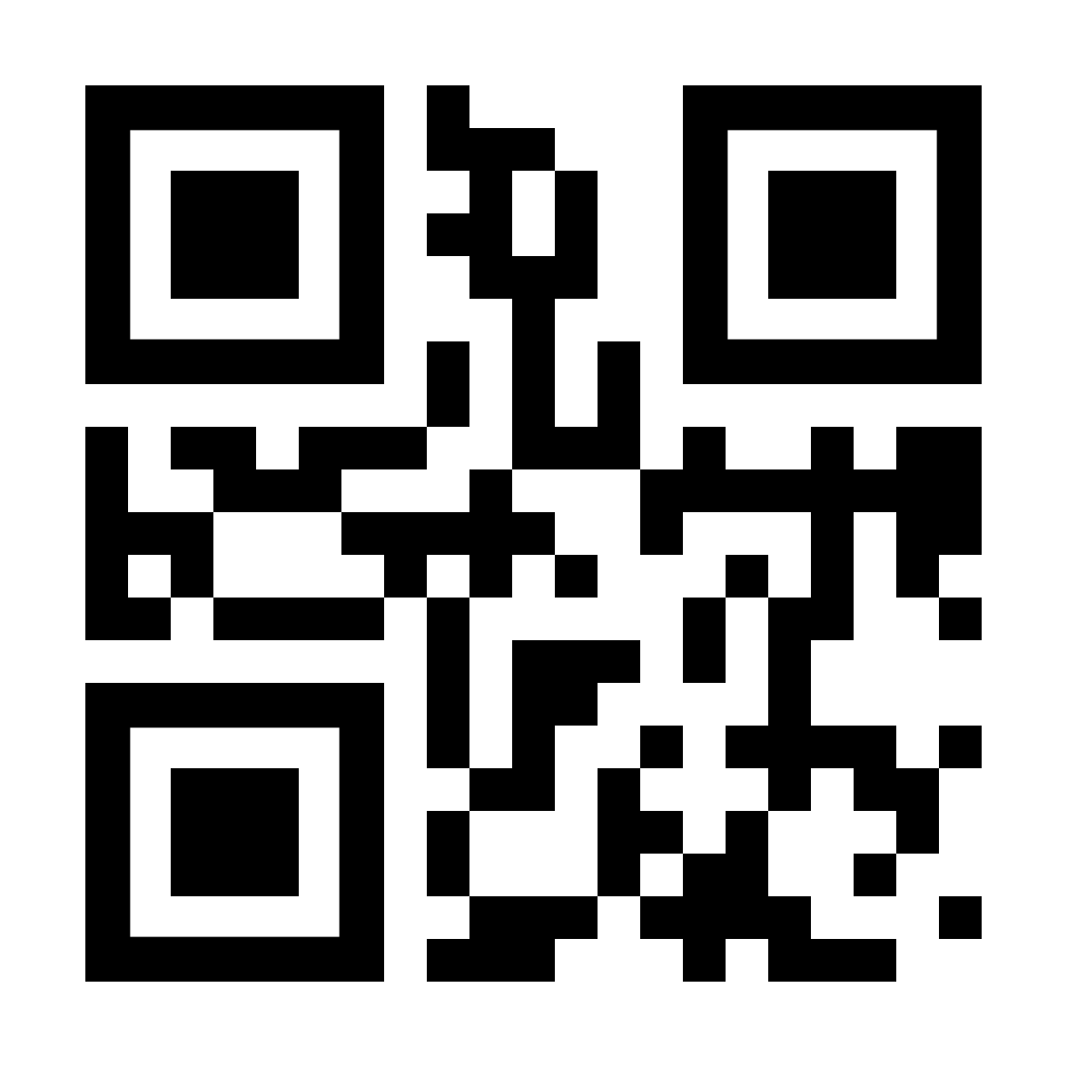
THE ABP PLATFORM
https://github.com/abpframework
https://abp.io

Slide 4

AGENDA
On premises vs Software-as-a-Service (SaaS)
What is multi-tenancy?
Deployment / database options
Implementing a multi-tenant application
Demo: Working with ABP Framework

Slide 5
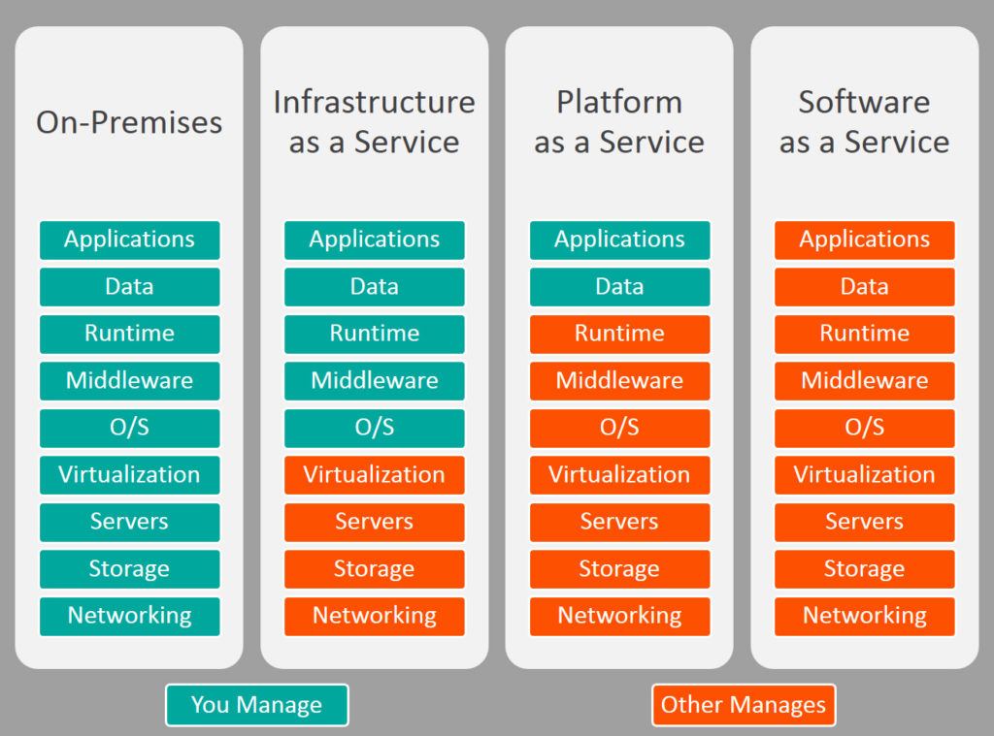


ON-PREMISES → SAAS

Slide 6
WHAT IS MULTI-TENANCY?
Sharing hardware and software resources among multiple customers
Hardware: CPU, RAM, ...
Software: OS, Runtime, Database, ...
Pros
Maximum Utilization / Low Costs
Easy to add a new client (tenant)
All clients use the same application version: Easy to maintain
Cons
Data Isolation
Performance sharing
Configuration & customization
Backup (per tenant)

Slide 7
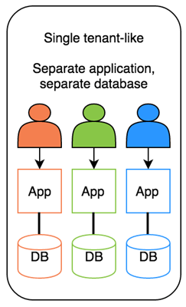
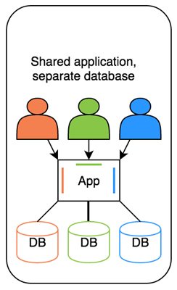
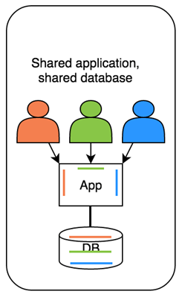
DEPLOYMENT / DATABASE OPTIONS
Hybrid!

Slide 8
IMPLEMENTING A MULTI-TENANT APP
Determining & changing the current tenant
Isolating & filtering database & cache
Enable/disable multi-tenancy
Migrating databases
Feature system

Slide 9

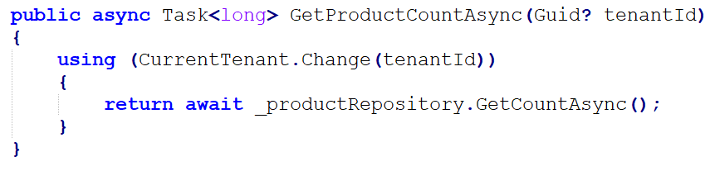
DETERMINE THE CURRENT TENANT
Sources
Current claims (for authenticated users)
Subdomain/domain example: https://tenant-name.mydomain.com
Others: HTTP header, cookies or query string
Obtaining the current tenant id: ICurrentTenant.Id
Switching to another tenant context:

Slide 10
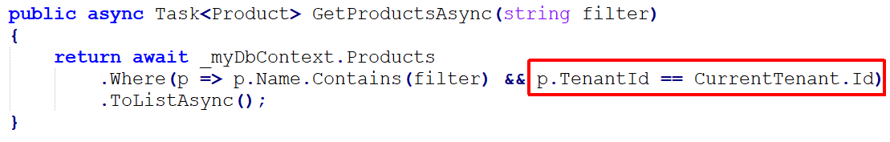
DATA ISOLATION: FILTERING DATA
Dynamically select the connection string;
Store/manage connection strings of tenants
Use a factory method to create DbContextOptions that gets the current tenant’s connection string
Fallback to the shared connection string
Data Filtering
Automatic filtering options:
Repository pattern
EF Core global query filters
Row level security for SQL Server

Slide 11
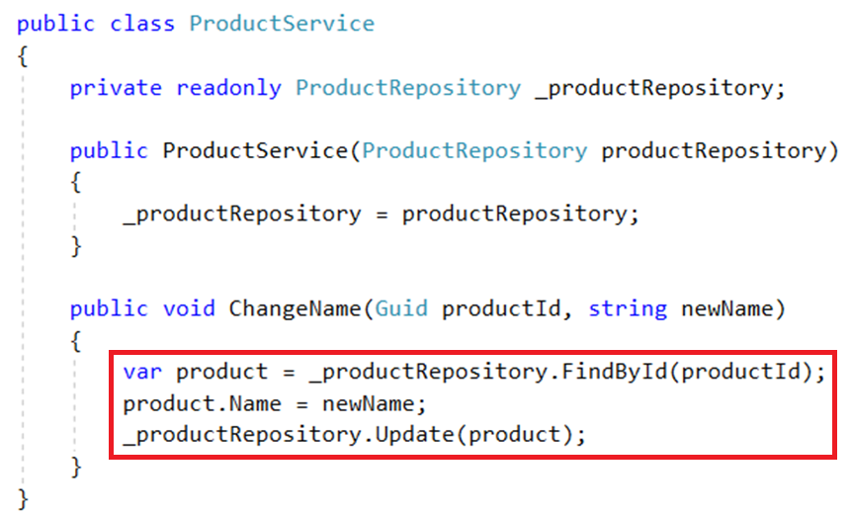
DATA ISOLATION: MANIPULATING DATA
Always query the data
Manipulate the data
Update the data

Slide 12
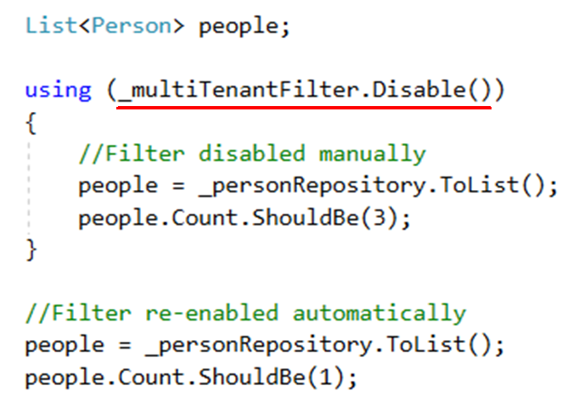
ENABLE/DISABLE BY SCOPE
Temporary disable multi-tenancy
Query on all tenants
Not practical on multi-database approach

Slide 13
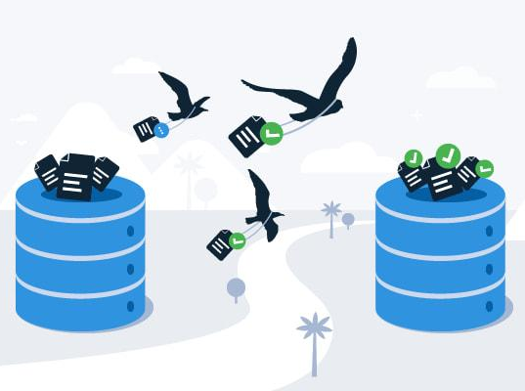
SCHEMA/DATA MIGRATION
Problem for multiple-databases approach
Option - 1: Upgrade all in one with a custom tool
Option - 2: Upgrade the application servers immediately, upgrade databases individually on first access
Option – 3: Multiple application versions runs concurrently, migrate updated tenants to the new version

Slide 14
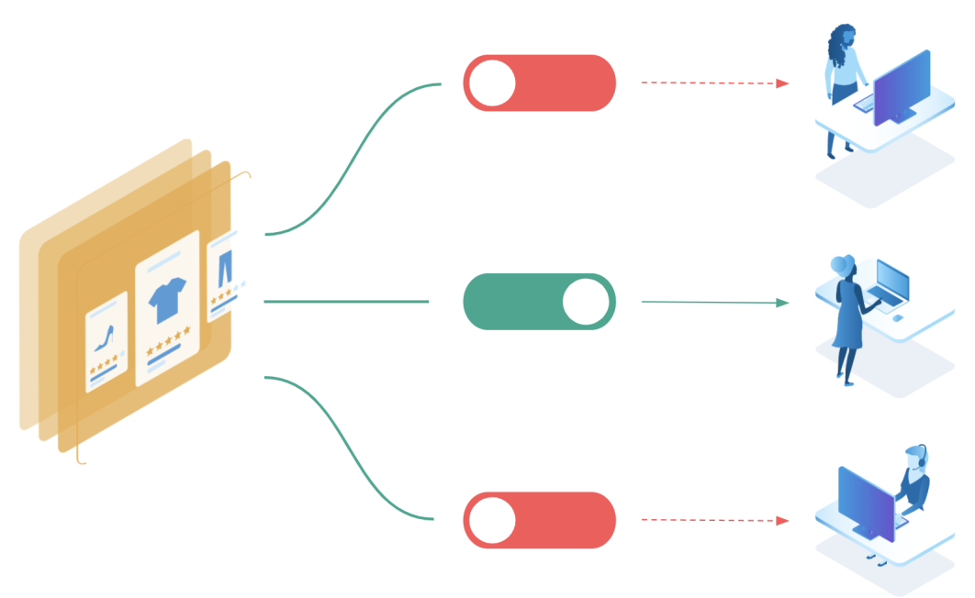
FEATURE / PACKAGE SYSTEM
Define features of the application
Feature types:
On/Off: Excel export, Replying by email (for a support app)
Numeric:10 users, 20,000 emails/month
Selection: one of the available options
Group features into packages/editions
Subscribe packages by tenants
Check features: Declarative or by code

Slide 15
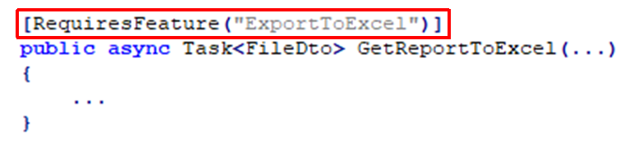
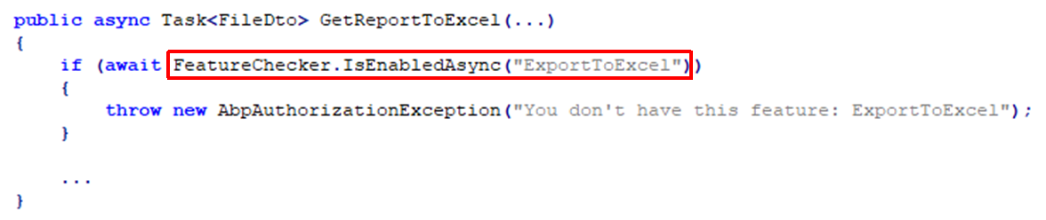
FEATURE CHECKING

Slide 16

DEMO
Creating ABP solutions
Demonstrate how multi-tenancy works out-of-the-box
Live coding examples

Slide 17
DEVELOPING MULTI-TENANT APPLICATIONS WITH .NET & ABP FRAMEWORK
Halil İbrahim Kalkan Co-founder & Lead Architect at Volosoft
Slide e materiale su
https://www.dotnetconference.it/

Slide 18


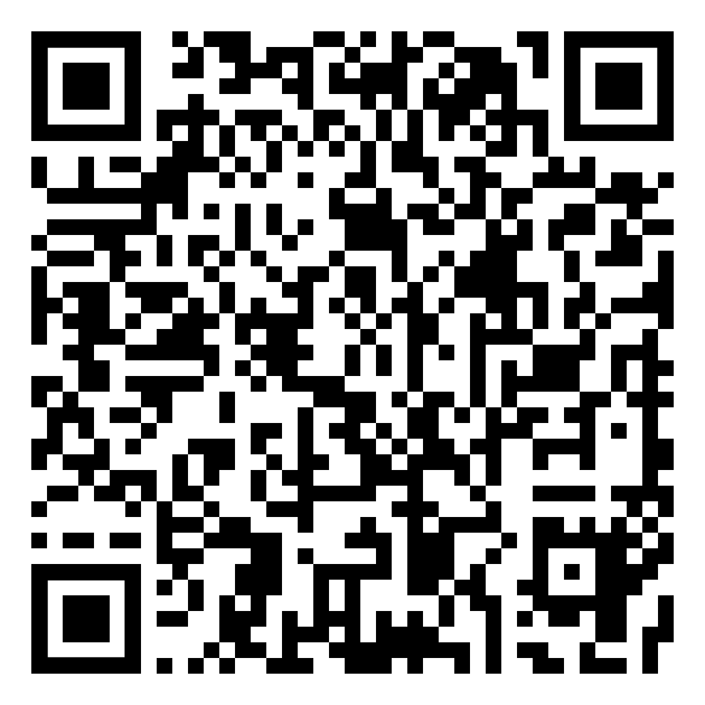
THANKS FOR
LISTENING
get the presentation
Halil İbrahim KALKAN
Co-founder & Lead Architect at Volosoft
hibrahimkalkan
hikalkan

Slide 19

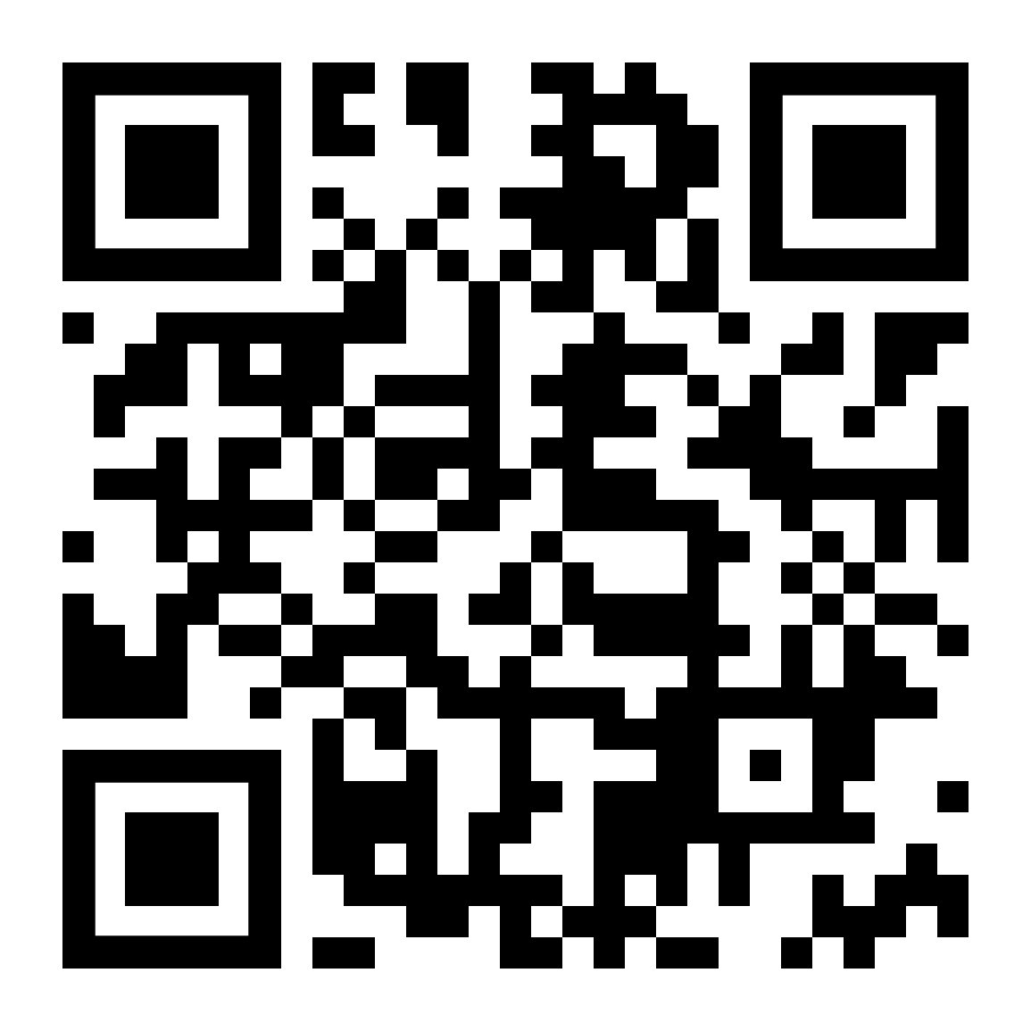
DEVELOPING MULTI-TENANT APPLICATIONS WITH .NET & ABP FRAMEWORK
Follow me on X (Twitter)
Halil İbrahim KALKAN
Co-founder & Lead Architect at Volosoft
hibrahimkalkan
hikalkan

Slide 20
TITLE
.

Slide 21
TITLE
.

